Slide 1
Graph DB
Introduction to Modeling
October 19, 2018
KROLL BOND RATING AGENCY, INC

Slide 2
Setup
Scenario
Survey
Spreadsheet
Story
Switch
Sample

Slide 3
Scenario
The director of an IT organization has directed managers of Pods to collect an inventory of all the technical skills, hobbies, interests, and research projects of their developers

Slide 4
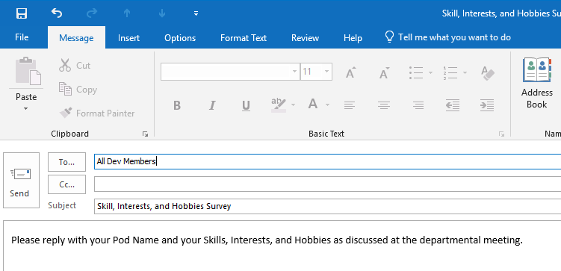
Survey

Slide 5
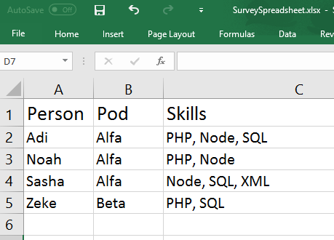
Spreadsheet

Slide 6
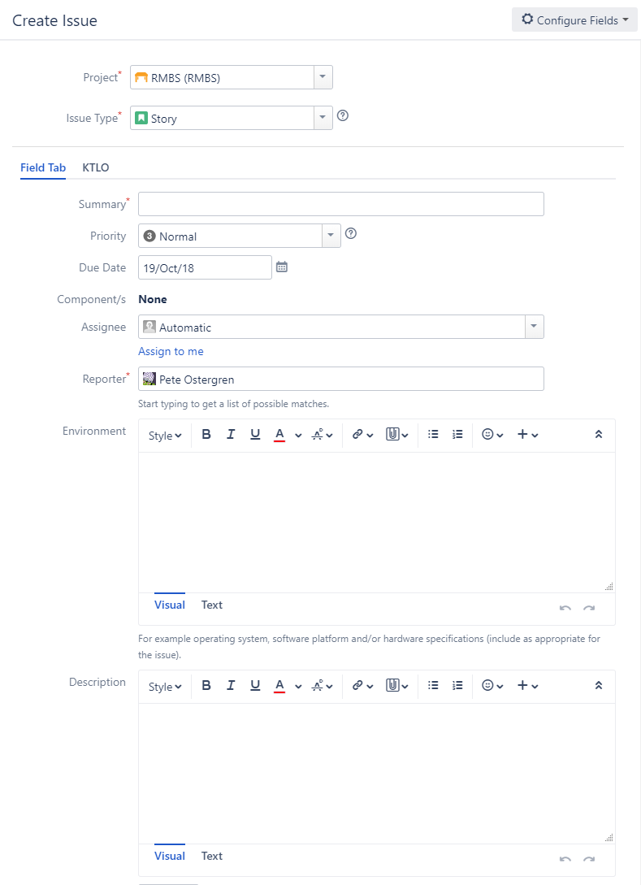
Story
Graph DB
As a developer
I want to know who in my pod has similar skills/interests to me
So that I can get help improving my skills

Slide 7
Switch
Pose it as a Question
Which people, who are in the same pod
As me, have similar skills/interests as me?
Identify the Entities
Person
Pod
Skill
Identify the Relationships between Entities
Person WORKS_IN Pod
Person HAS_SKILL Skill
Convert to Cypher Path Expressions
(:Person)-[:WORKS_IN]->(:Pod)
(:Person)-[:HAS_SKILL]->(:Sill)
Apply DRY and Refactor
(:Pod)<-[:WORKS_IN]-(:Person)-[:HAS_SKILL]->(:Sill)

Slide 8
Sample
Apply DRY and Refactor
(:Pod)<-[:WORKS_IN]-(:Person)-[:HAS_SKILL]->(:Sill)
Pod
Person
Skill
WORKS_IN
HAS_SKILL
Load Nodes, assign Relationships
Pod
Person
Skill

Slide 9
So What’s Next?
You
Install Neo4j
You
Load the Nodes
You
Assign the Relationships
We answer the question
Which people, who are in the same pod
As me, have similar skills/interests as me?
By converting pattern to a Cypher Query
pod
Pod
WORKS_IN
me
colleague
Person
HAS_SKILL
skill
Skill

